Slide 1
SQL 寫法
順序寫法
SELECT “欄位名稱“ FROM “表格名稱”
WHERE “條件式”
ORDER BY “欄位名稱” [ASC, DESC]
GROUP BY “欄位名稱”
HAVING “函數條件”
ASC - 從小到大
DESC - 從大到小

Slide 2
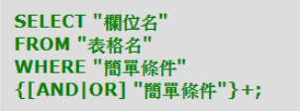
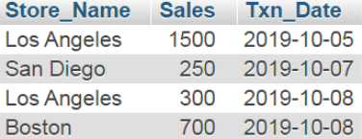

SQL AND OR
寫法：
程式碼：
SELECT Store_Name FROM store_information WHERE Sales > 1000 OR (Sales BETWEEN 275 AND 500)

Slide 3
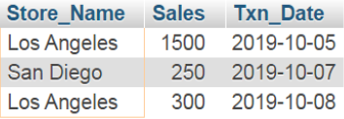
SQL IN
寫法：
程式碼：
SELECT * FROM `store_information`
WHERE Store_Name IN ("Los Angeles", "San Diego")

Slide 4

SQL BETWEEN
寫法：
程式碼：
SELECT * FROM `store_information` WHERE Txn_Date BETWEEN "2019-10-06" AND "2019-10-08"

Slide 5

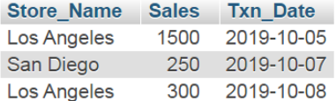
SQL LIKE
寫法：
程式碼：
SELECT * FROM `store_information`
WHERE Store_Name LIKE "%AN%"

Slide 6

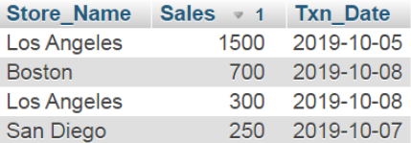
SQL ORDER BY
寫法：
程式碼：
SELECT Store_Name, Sales, Txn_Date FROM `store_information`
ORDER BY Sales DESC

Slide 7

SQL AVG()函數 + Example
計算平均值
程式碼：
SELECT AVG(Sales) FROM `store_information`

Slide 8

SQL An Example
COUNT( ) 函數,Sales > 700
程式碼：
SELECT COUNT(Store_Name) FROM `store_information`
WHERE (Store_Name IS NOT NULL) AND Sales > 700

Slide 9


SQL COUNT( )函數
寫法：
程式碼：
SELECT COUNT(Store_Name) FROM `store_information`

Slide 10


SQL MAX()函數 + Example
寫法：
程式碼：
SELECT MAX(Sales) FROM `store_information`

Slide 11


SQL MIN()函數 + Example
寫法：
程式碼：
SELECT MIN(Sales) FROM `store_information`

Slide 12


SQL SUM()函數 + Example
寫法：
程式碼：
SELECT SUM(Sales) FROM `store_information`

Slide 13

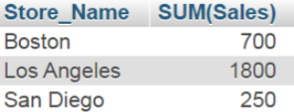
SQL GROUP BY
寫法：
程式碼：
SELECT Store_Name, SUM(Sales) FROM `store_information`
GROUP BY Store_Name

Slide 14
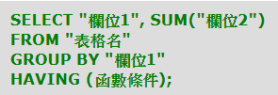

SQL HAVING
寫法：
程式碼：
SELECT Store_Name, SUM(Sales) FROM `store_information`
GROUP BY Store_Name
HAVING SUM(Sales) > 1500

